Slide 1
Local Winds
Defined as winds that develop due to local surface differences in heating and cooling.
Develop best in otherwise clear and calm conditions, where daytime solar radiation input or nightime terrestrial radiation output are maximized.
Types:
Sea breezes happen when interior areas heat up more than adjoining sea surfaces and wind blows onshore (late morning through early evening typically strongest)
Land breezes happen at night when strong nighttime radiational cooling of land makes surface cooler than the adjoining sea areas. Offshore flow.
Thermal (aka upslope) winds happen during daytime surface heating of slopes. Movement is upslope.
Katabatic or drainage winds happen when efficient nighttime radiation cooling of slopes forms a layer of relatively cold and therefore dense air that flows under force of gravity downhill.
Valley winds flow up valleys into heated adjoining mountains, while in the same environments nightime mountain winds flow downhill and downvalley (see next slide for more)

Slide 2
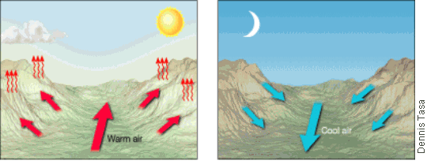
Valley and Mountain Breezes
A daily wind similar to land and sea breezes occurs in many mountainous regions. During daylight hours, the air along the slopes of the mountains is heated more intensely than the air at the same elevation over the valley floor. Because this warmer air on the mountain slopes is less dense, it glides up along the slope and generates a valley breeze (Figure A). The occurrence of these daytime upslope breezes can often be identified by the cumulus clouds that develop on adjacent mountain peaks.
After sunset, the pattern may reverse. The rapid cooling of the air along the mountain slopes produces a layer of cooler air next to the ground. Because cool air is denser than warm air, it moves downslope into the valley. Such a movement of air (Figure B), is called a mountain breeze. In the Grand Canyon at night, the sound of cold air rushing down the sides of the canyon can be louder than the sound of the Colorado River below. Source here.

Slide 3
Monsoonal Wind Systems
Seasonal wind changes that happen at a regional/continental scale due to seasonal reversals of onshore-offshore temperature differences.
Summer: onshore circulations from very warm oceans, rain!
Winter: offshore circulations, dry
Where? S & SE Asia, Eq. Africa, a bit of S. America

Slide 4
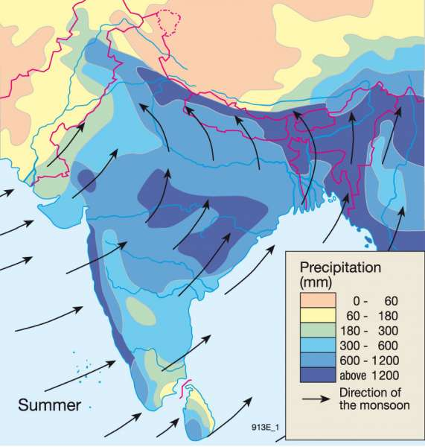
South Asian Summer Monsoon

